Slide 1

Coaching Session Presentation
Tien Phan
LUMA Practitioner Program • Follow-up Coaching
LUMA Institute and its licensors • CONFIDENTIAL
LUMA INSTITUTE
1

Slide 2

A FEW WORDS ABOUT MY CHALLENGE
As a parent of two young daughters (ages 4 and 2), I need to design meaningful, age-appropriate after-school activities that a caregiver can independently follow and instruct — while complementing their Steiner (Waldorf) education.
👧 Two daughters — ages 4 and 2 — come home from school at 4 PM every weekday
👩‍👧‍👧 A caregiver supervises while both parents are at work
🎓 Both attend a Steiner (Waldorf) school
📋 Activities must be simple enough for the caregiver to follow independently
🌈 Must be diverse, age-appropriate, and complement Steiner philosophy
🧩 May draw from Montessori & Reggio Emilia to fill developmental gaps
LUMA Institute and its licensors • CONFIDENTIAL
LUMA INSTITUTE
2

Slide 3
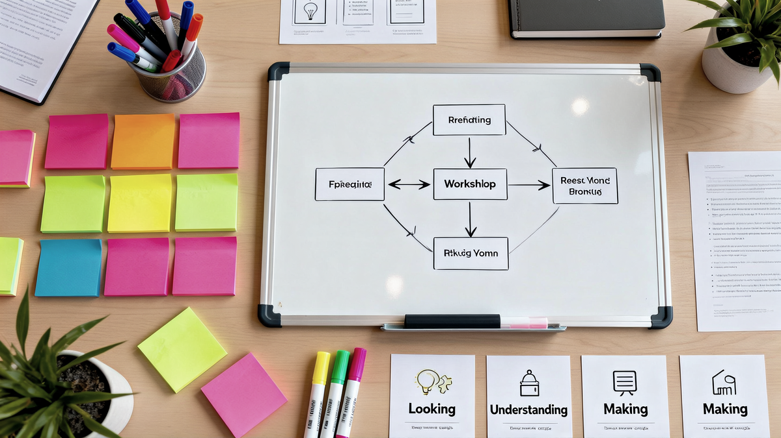
METHODS USED
Looking: Methods for Observing Human Experience
• Walk-a-Mile Immersion — experiencing the caregiver's daily routine firsthand
• Interviewing — conversations with caregiver and teachers
Understanding: Methods for Analyzing Challenges & Opportunities
• Stakeholder Mapping — identifying all people involved and their needs
• Rose, Thorn, Bud — evaluating previous activity plans
Making: Methods for Envisioning Future Possibilities
• Creative Matrix — cross-referencing activity types with developmental goals
LUMA Institute and its licensors • CONFIDENTIAL
LUMA INSTITUTE
3

Slide 4

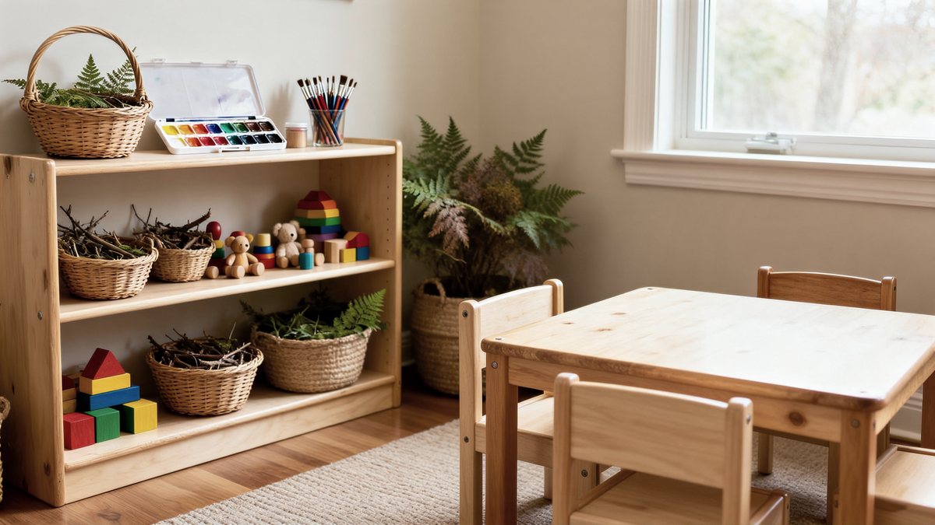
APPROACH
Looking: Observing Human Experience
1. Walk-a-Mile Immersion
I spent a full afternoon shadowing the caregiver to experience the daily routine firsthand — from school pickup to bedtime.
Goal: understand what the caregiver actually faces — time constraints, the children's energy levels, available materials, and space limitations.
I observed how the children transition between activities, what captures their attention, and where they lose interest.
This immersion revealed that the caregiver struggles most during the 4:30–5:30 PM window when both children need different types of engagement.
LUMA Institute and its licensors • CONFIDENTIAL
LUMA INSTITUTE
4

Slide 5

APPROACH
Looking: Observing Human Experience
2. Interviewing
I interviewed the caregiver to understand her comfort level, what activities she finds easy or difficult to lead, and her observations about each child's preferences.
I also spoke with the Steiner school teachers to learn about the children's classroom activities, developmental milestones, and recommended at-home extensions.
Key insights collected:
The caregiver prefers visual, step-by-step instructions over written paragraphs
The 4-year-old thrives with creative and imaginative play
The 2-year-old needs more sensory and motor-skill activities
Teachers recommended nature-based and hands-on activities
These insights directly shaped the activity plan design
LUMA Institute and its licensors • CONFIDENTIAL
LUMA INSTITUTE
5

Slide 6
APPROACH
Understanding: Analyzing Challenges & Opportunities
3. Stakeholder Mapping
Children (ages 4 & 2)
Caregiver
Parents (Tien & wife)
School Teachers
Primary beneficiaries Different developmental needs Different attention spans
Daily executor of activities Needs simple instructions Limited educational background
Activity designers & planners Weekly iteration & feedback Quality oversight
Educational philosophy input Developmental milestone guidance Activity recommendations
Why Stakeholder Mapping mattered:
Clarified each person's role and constraints • Ensured no perspective was missed • Revealed the caregiver as the critical success factor
LUMA Institute and its licensors • CONFIDENTIAL
LUMA INSTITUTE
6

Slide 7

APPROACH
Making: Envisioning Future Possibilities
4. Creative Matrix
Key outcomes from the matrix:
I cross-referenced activity categories with developmental goals for each age group. This systematic approach generated a wide range of ideas and ensured balanced coverage.
Generated 30+ activity ideas across 5 categories
Filtered down to 15 core activities per age group
Identified activities that work for both ages simultaneously
Flagged activities needing special materials or preparation
Created a balanced weekly rotation template
LUMA Institute and its licensors • CONFIDENTIAL
LUMA INSTITUTE
7

Slide 8
OUTCOMES
1. Structured weekly activity plan
2. Visual instruction cards for the caregiver
Monday–Friday schedule tailored to each child's age
Balanced mix: creative play, motor skills, language, sensory, nature
Activities complement Steiner while introducing Montessori & Reggio elements
Simple, step-by-step cards with illustrations
Caregiver can follow independently — no phone calls needed
Color-coded by activity type for quick reference
3. Weekly feedback loop established
4. Caregiver confidence significantly improved
Caregiver notes what works and what doesn't each day
Parents review and iterate the plan every weekend
Continuous improvement built into the process
From uncertain and dependent → confident and autonomous
Children show higher engagement and less screen time
Parents feel peace of mind during work hours
LUMA Institute and its licensors • CONFIDENTIAL
LUMA INSTITUTE
8

Slide 9
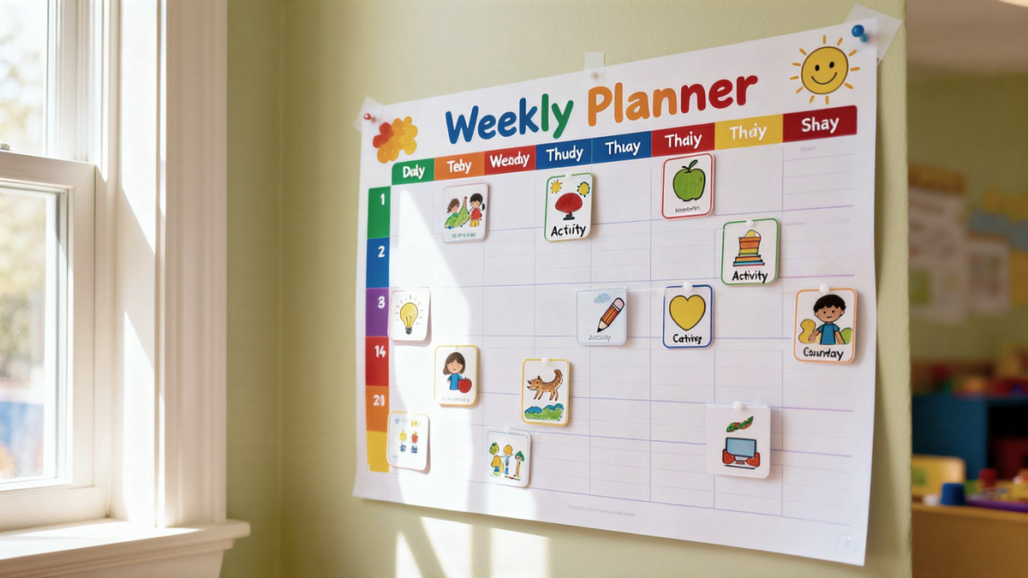



OUTCOMES
The process transformed our after-school routine from ad-hoc and stressful into a structured, joyful experience for everyone involved. The children now look forward to their afternoon activities. The caregiver feels empowered and confident. And as parents, we have peace of mind knowing our daughters are engaged in meaningful, developmentally appropriate play — even when we can't be there.
LUMA Institute and its licensors • CONFIDENTIAL
LUMA INSTITUTE
9

Slide 10
EVALUATE YOUR APPLICATION OF METHODS
Reflect on how it went by recording a Rose, a Thorn, and a Bud:
🌹 Rose (Positive)
🥀 Thorn (Challenge)
🌱 Bud (Potential)
Design Thinking made the planning process systematic instead of ad-hoc
Stakeholder Mapping ensured no perspective was missed
Walk-a-Mile revealed real constraints the caregiver faces daily
The caregiver reported higher confidence and children show more engagement
Time-consuming to prepare detailed visual instruction cards initially
Hard to predict which activities suit a 2-year-old vs. a 4-year-old perfectly
Caregiver needed an adjustment period to follow the new structured format
Build a reusable activity template library for each age group
Explore co-designing activities with the children themselves
Extend the approach to weekends and holidays
Share the framework with other parents in the school community
Evaluation Criteria
▸ Application:
Walk-a-Mile and Interviewing created firsthand insights; Stakeholder Mapping clarified responsibilities; Creative Matrix generated structured ideas
▸ Communication:
Visual instruction cards shared with caregiver; Weekly feedback forms; Presentation artifacts for coaching peers
▸ Outcome:
Tangible weekly plan and instruction cards produced; Caregiver autonomy achieved; Children's engagement improved measurably
LUMA Institute and its licensors • CONFIDENTIAL
LUMA INSTITUTE
10

Slide 11

I'D LIKE TO LEARN MORE ABOUT...
Input an item or two that you'd like to learn more about during the coaching session.
1. How to better sequence LUMA methods for personal (non-work) challenges — especially when the "users" are very young children
2. Tips for facilitating co-design sessions with toddlers and preschoolers — making LUMA methods accessible for ages 2–4
3. How to create lightweight, visual artifacts that non-designers (like a caregiver) can use and iterate on independently
4. How peers have applied Design Thinking outside of traditional work contexts — personal life, family, community
Thank you! Looking forward to your feedback and questions.
LUMA Institute and its licensors • CONFIDENTIAL
LUMA INSTITUTE
11

